Slide 1
OBJECT ORIENTED PROGRAMMING
(23EN1202)
UNIT-3: DATA STRUCTURES IN PYTHON

Slide 2
content
A data structure is a group of data elements that are put together under one name.
Data structure defines a particular way of storing and organizing data in a computer so that it can be used efficiently.
Sequence is the most basic data structure in python. It is a collection of elements arranged in a particular order.
In the sequence data structure, each element has a specific index (starts from zero and is automatically incremented for the next element in the sequence)
Ex: Strings – sequence of characters
Lists, Tuples – type of sequence

Slide 3
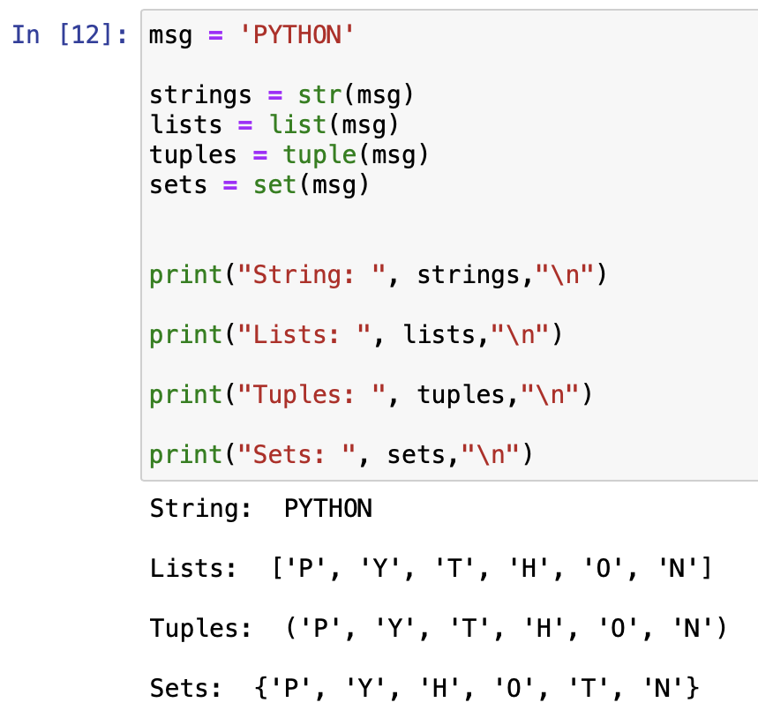
Terminologies
Ordered and Unordered
Ordered/Indexed – Ordered means that the data structure retains the ordering as provided by the programmer
Ex: String, List and Tuples
Unordered - Unordered means that the data structure doesn’t have a specific order, and doesn’t care about any ordering by the programmer
Ex: Sets and Dictionaries

Slide 4
Mutable and Immutable
Immutable - if the value of an object cannot be changed over time, then it is known as immutable. Once created, the value of these objects is permanent
Ex: Strings, Tuples and Frozen-sets
Mutable – is the ability of objects to change their values. Mutable objects are those whose internal state can be changed after creation.
Ex: List, Set and Dictionary

Slide 5
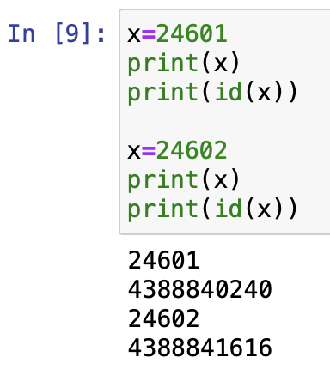
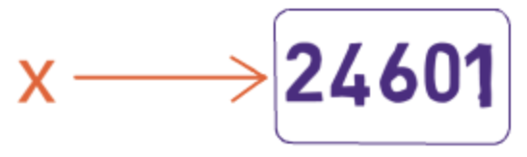
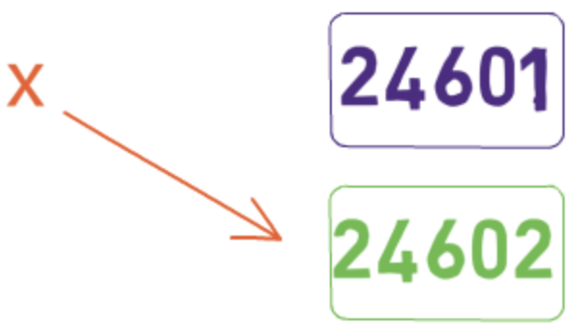
Ex: int objects are immutable in python
Created a new object and bound the name x to this new object. The other object with the value of 24601 is no longer reachable by x

Slide 6
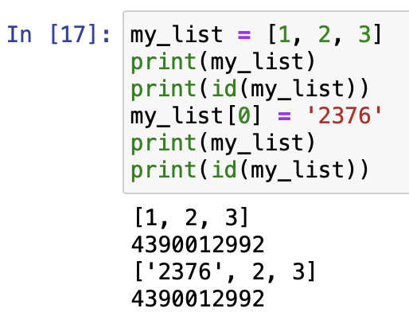
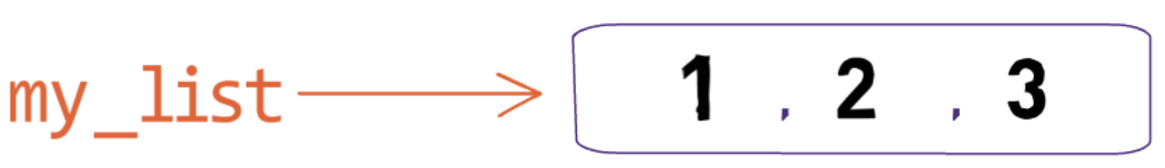

Ex: List objects are mutable in python
4390012992
2376, 2, 3
4390012992

Slide 7
Data-structures
Types of Data Structures
Strings – immutable ordered sequence of characters
EX: S = ‘abc’ or S = “abc” or S = ‘‘‘abc’’’
List – mutable ordered sequence of objects
EX: L = [1,2,’a’]
Tuples – immutable ordered sequence of objects
EX: T = (1,2,’a’)
Sets – mutable unordered sequence of unique element
EX: S = {1,2,3}
Frozen-sets – same as Sets but it is immutable
EX: FS = frozenset(s)
Dictionaries – mutable unordered collection of value pairs (mapping unique key to value)
EX: D = {1:’Karnataka’,2:’Kerala’,3:’Tamil Nadu’}

Slide 8
LIST

Slide 9
List:
It is a data structure in Python. Lists are used to store multiple items in a single variable.
A list is an ordered sequence of values and are mutable/changeable.
The values inside the lists can be of any type (like integer, float, strings, lists, tuples, dictionaries etc..) and are called as elements or items.
Lists are written with square brackets.
Example:
mylist=[10,-4, 25, 13]
print(mylist)
Output:
[10,-4, 25, 13]
List items are indexed, the first item has index [0], the second item has index [1] etc.
0 | 1 | 2 | 3
10 | -4 | 25 | 13

Slide 10
List Items - Data Types: List items can be of any data type
Example:
list1 = ["apple", "banana", "cherry"] list2 = [1, 5, 7, 9, 3] list3 = [True, False, False]
print(list1)
print(list2)
print(list3)
Output:
['apple', 'banana', 'cherry‘]
[1, 5, 7, 9, 3]
[True, False, False]

Slide 11
List Items - Data Types: A list can contain different data types
Example:
list1 = ["abc", 34, True, 40, "male"]
print(list1)
Output:
['abc', 34, True, 40, 'male‘]

Slide 12
Allow Duplicates: Since lists are indexed, they can have items with the same value:
Example:
mylist =["apple", "banana", "cherry", "apple", "cherry"] print(mylist)
Output:
['apple', 'banana', 'cherry', 'apple', 'cherry']

Slide 13
type(): From Python's perspective, list are defined as objects with the data type ‘list'
<class 'list'>
Example:
mylist = ["apple", "banana", "cherry"] print(type(mylist))
Output:
<class 'list'>

Slide 14
The list() Constructor: It is also possible to use the list() constructor to make a list.
Example:
mylist = list(("apple", "banana", "cherry")) print(mylist)
Output:
['apple', 'banana', 'cherry‘]

Slide 15
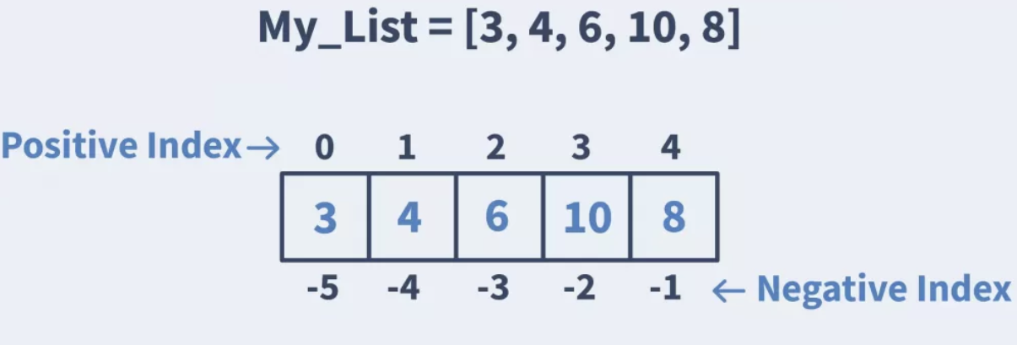
Access List Items: You can access list items by referring to the index number, inside square brackets
Example:
my_list = [3,4,6,10,8] print(mylist[1])
Output: 4
Negative Indexing: Negative indexing means start from the end. -1 refers to the last item, -2 refers to the second last item etc.
Example:
my_list = [3,4,6,10,8] print(mylist[-1])
Output: 8

Slide 16
Range of Indexes: You can specify a range of indexes by specifying where to start and where to end the range.
When specifying a range, the return value will be a new list with the specified items.
Example: Return the third, fourth, and fifth item
mylist = ["apple", "banana", "cherry", "orange", "kiwi", "melon", "mango"] print(mylist[2:5])
Output:
['cherry', 'orange', 'kiwi']
Note: The search will start at index 2 (included) and end at index 5 (not included).
------------------------------------------------------------------------------------------------------------------------------------------
0 | 1 | 2 | 3 | 4 | 5 | 6
apple | banana | cherry | orange | kiwi | melon | mango

Slide 17
Example: returns the items from the beginning to, but NOT including, "kiwi"
mylist =["apple", "banana", "cherry", "orange", "kiwi", "melon", "mango"] print(mylist[:4])
Output:
['apple', 'banana', 'cherry', 'orange']
0 | 1 | 2 | 3 | 4 | 5 | 6
apple | banana | cherry | orange | kiwi | melon | mango

Slide 18
Example: returns the items from "cherry" to the end
mylist = ["apple", "banana", "cherry", "orange", "kiwi", "melon", "mango"] print(mylist[2:])
Output:
['cherry', 'orange', 'kiwi', 'melon', 'mango’]
--------------------------------------------------------------------------------------
0 | 1 | 2 | 3 | 4 | 5 | 6
apple | banana | cherry | orange | kiwi | melon | mango

Slide 19
Range of Negative Indexes: Specify negative indexes if you want to start the search from the end of the tuple, returns the items from "orange" (-4) to, but NOT including "mango" (-1)
Example:
mylist=["apple", "banana", "cherry", "orange", "kiwi", "melon", "mango"] print(mylist[-4:-1])
Output:
['orange', 'kiwi', 'melon']
0 | 1 | 2 | 3 | 4 | 5 | 6
apple | banana | cherry | orange | kiwi | melon | mango
-7 | -6 | -5 | -4 | -3 | -2 | -1

Slide 20
Change item value:
Example: Change the second item
thislist = ["apple", "banana", "cherry"] thislist[1] = "blackcurrant" print(thislist)
Output:
["apple", "blackcurrant", "cherry"]
--------------------------------------------------------------------------------------
0 | 1 | 2
0 | 1 | 2
apple | banana | cherry
apple | blackcurrant | cherry

Slide 21
Change a range of item values: To change the value of items within a specific range, define a list with the new values, and refer to the range of index numbers where you want to insert the new values
Example: Change the values "banana" and "cherry" with the values "blackcurrant" and "watermelon"
thislist = ["apple", "banana", "cherry", "orange", "kiwi", "mango"] thislist[1:3] = ["blackcurrant", "watermelon"] print(thislist)
Output:["apple", "blackcurrant", "watermelon", "orange", "kiwi", "mango"]
0 | 1 | 2 | 3 | 4 | 5 | 6
apple | banana | cherry | orange | kiwi | melon | mango
0 | 1 | 2 | 3 | 4 | 5 | 6
apple | black currant | watermelon | orange | kiwi | melon | mango

Slide 22
Change a range of item values: If you insert more items than you replace, the new items will be inserted where you specified, and the remaining items will move accordingly
Example: Change the second item value by replacing it with two new values
thislist = ["apple", "banana", "cherry"] thislist[1:2] = ["blackcurrant", "watermelon"] print(thislist)
Output:
["apple", "blackcurrant", "watermelon", "cherry"]
--------------------------------------------------------------------------------------
0 | 1 | 2
0 | 1 | 2 | 3
apple | banana | cherry
apple | black currant | watermelon | cherry

Slide 23
Change a range of item values:
Example: Change the second and third value by replacing it with one value
thislist = ["apple", "banana", "cherry"] thislist[1:3] = ["watermelon"] print(thislist)
Output:
["apple", "watermelon"]
0 | 1 | 2
0 | 1
apple | banana | cherry
apple | Watermelon

Slide 24
Python has a set of built-in methods that you can use on lists
Method | Description
append() | Adds an element at the end of the list
insert() | Adds an element at the specified position
extend() | Add the elements of a list (or any iterable), to the end of the current list
clear() | Removes all the elements from the list
count() | Returns the number of elements with the specified value
index() | Returns the index of the first element with the specified value
pop() | Removes the element at the specified position
remove() | Removes the first item with the specified value
copy() | Returns a copy of the list
reverse() | Reverses the order of the list
sort() | Sorts the list

Slide 25
append() - The append() method appends an element to the end of the list.
Syntax: list.append(elmnt)
Example: Add an element to list
a = ["apple", "banana", "cherry"] a = ["apple", "banana", "cherry"] b = “watermelon” OR a.append(“watermelon”) a.append(b)
Output:
['apple', 'banana', 'cherry', ‘watermelon']
elmnt | Required. An element of any type (string, number, object etc.)

Slide 26
extend() method - adds the specified list elements (or any iterable) to the end of the current list. Syntax: list.extend(iterable)
iterable | Required. Any iterable (list, set, tuple, etc.)
a = ["apple", "banana", "cherry"]
b = ["Ford", "BMW", "Volvo"]
a.extend(b)
print(a)
Output:
['apple', 'banana', 'cherry', 'Ford', 'BMW', 'Volvo']

Slide 27
insert() - The insert() method inserts an item at the specified index
Syntax: list.insert(pos, elmnt)
Example:
vowels=['a','i','o','u']
print("old list =",vowels)
vowels.insert(1,'e')
print("new list =",vowels)
Output:
old list = ['a', 'i', 'o', 'u']
new list = ['a', 'e', 'i', 'o', 'u']
--------------------------------------------------------------------------------------
pos | Required. A number specifying in which position to insert the value
elmnt | Required. An element of any type (string, number, object etc.)
0 | 1 | 2 | 3
a | i | o | u
0 | 1 | 2 | 3 | 4
a | e | i | o | u

Slide 28
clear() method - removes all the elements from a list. Syntax: list.clear()
Example:
list1=[1,2,3,4,5]
print(list1)
list1.clear()
print(list1)
Output:
[1, 2, 3, 4, 5]
[ ]

Slide 29
count() method - returns the number of elements with the specified value
Syntax: list.count(value)
Example:
points = [1, 4, 2, 9, 7, 8, 9, 3, 1]
x = points.count(9)
print(x)
Output:
2
value | Required. Any type (string, number, list, tuple, etc.). The value to search for.

Slide 30
index() method - returns the index at the first occurrence of the specified value. If the element is not found it valueerror exception is thrown.
Syntax: list.index(elmnt)
Example:
list1=[4, 55, 64, 32, 16, 32]
x = list1.index(32)
print(x)
Output:
3
elmnt | Required. Any type (string, number, list, etc.). The element to search for
0 | 1 | 2 | 3 | 4 | 5
4 | 55 | 64 | 32 | 16 | 32

Slide 31
pop() method removes the element at the specified position.
Syntax: list.pop(pos)
Pop Element at the Given Index from the List:
Example:
language = ['Python', 'Java', 'C++', 'French', 'C’]
print(‘Old List: ', language)
value = language.pop(3)
print(‘Popped Value: ', value)
print('Updated List: ', language)
Output:
Old List = ['Python', 'Java', 'C++', 'French', 'C’]
Popped Value: French
Updated List: ['Python', 'Java', 'C++', 'C']
--------------------------------------------------------------------------------------
pos | Optional. A number specifying the position of the element you want to remove, default value is -1, which returns the last item
0 | 1 | 2 | 3 | 4
Python | Java | C++ | French | C
Python | Java | C++ | C

Slide 32
0 | 1 | 2 | 3
pop() when index is not passed:
Example:
language = ['Python', 'Java', 'C++', 'C']
print(‘Popped Value: ', language.pop())
print('Updated List: ', language)
print(‘Popped Value: ', language.pop(-1))
print('Updated List: ', language)
Output:
Popped Value: C
Updated List: ['Python', 'Java', 'C++’]
Popped Value: C++
List: ['Python', 'Java']
-------------------------------------------------------------------------------------
Python | Java | C++ | C
pop()
Python | Java | C++
-3 | -2 | -1
pop(-1)
Python | Java

Slide 33
remove( ) method: removes the first occurrence of the element with the specified value.
Syntax: list.remove(elmnt)
The remove() method searches for the given element in the list and removes the first matching element.
The remove() method takes a single element as an argument and removes it from the list.
If the element(argument) passed to the remove() method doesn't exist, valueError exception is thrown.
Example:
list1 = [5,78,12,26,50]
print('Original list: ', list1)
list1.remove(12)
print('Updated list elements: ', list1)
Output:
Original list: [5, 78, 12, 26, 50]
Updated list: [5, 78, 26, 50]
-------------------------------------------------------------------------------------
elmnt | Required. Denotes the element you want to remove

Slide 34
Copy List: A list can be copied with = operator.
The problem with copying the list in this way is that if you modify the new_list, the old_list is also modified.
Example:
old_list = [1, 2, 3]
new_list = old_list
new_list.append('a')
print('New List:', new_list )
print('Old List:', old_list )
Output:
New List: [1, 2, 3, 'a’]
Old List: [1, 2, 3, 'a']
old_list
1 | 2 | 3
new_list
-----------------------------------------
After appending ‘a’ to new_list
-----------------------------------------
old_list
1 | 2 | 3 | a
new_list

Slide 35
copy( ): copy() method returns a copy of the specified list.
Syntax: list.copy()
We need the original list unchanged when the new list is modified, you can use copy() method.
The copy() method doesn't take any parameters and it returns a shallow copy of the list.
The copy() function returns a list. It doesn't modify the original list.
Example:
list1 = [1,2,4]
new_list = list1.copy()
new_list.append(5)
print('Old List: ', list1)
print('New List: ', new_list)
Output:
Old List: [1, 2, 4]
New List: [1, 2, 4, 5]
-------------------------------------------------------------------------------------
list1
1 | 2 | 4
new_list
1 | 2 | 4
----------------------------
After appending 5 to new_list
----------------------------
list1
1 | 2 | 4
new_list
1 | 2 | 4 | 5

Slide 36
reverse( ) method: reverse() method reverses the order of the elements.
Syntax: list.reverse()
The reverse() function doesn't return any value. It only reverses the elements and updates the list.
Example:
list1 = [1,5,8,6,11,55]
print('Original List:', list1)
list1.reverse()
print('Reversed List:', list1)
Output:
Original List: [1, 5, 8, 6, 11, 55]
Reversed List: [55, 11, 6, 8, 5, 1]
-------------------------------------------------------------------------------------

Slide 37
sort( ) method:
The sort() method sorts the elements of a given list. It sorts the list ascending by default.
The sort() method sorts the elements of a given list in a specific order - Ascending or Descending.
Syntax: list.sort(reverse=True|False, key=myFunc)
Example:
list1 = [1,15,88,6,51,55]
print('Original List:', list1)
list1.sort()
print('sorted List:', list1)
Output:
Original List: [1, 15, 88, 6, 51, 55]
sorted List: [1, 6, 15, 51, 55, 88]
-------------------------------------------------------------------------------------
reverse | Optional. reverse=True will sort the list descending. Default is reverse=False
key | Optional. A function to specify the sorting criteria(s)

Slide 38
Sort the list descending
Example:
list1 = [1,15,88,6,51,55]
print('Original List:', list1)
list1.sort(reverse=True)
print('sorted List:', list1)
Output:
Original List: [1, 15, 88, 6, 51, 55]
sorted List: [88, 55, 51, 15, 6, 1]

Slide 39
Sort the list by the length of the values
def myFunc(e):
return len(e)
cars = ['Ford', 'Mitsubishi', 'BMW', 'VW']
cars.sort(key=myFunc)
print(cars)
Output:
['VW', 'BMW', 'Ford', 'Mitsubishi']

Slide 40
Sort the list descending and by the length of the values
def myFunc(e):
return len(e)
cars = ['Ford', 'Mitsubishi', 'BMW', 'VW']
cars.sort(reverse=True, key=myFunc)
print(cars)
Output:
['Mitsubishi', 'Ford', 'BMW', 'VW']

Slide 41
Arithmetic operation +, * on list:
Example:
ls1=[1,2,3]
ls2=[5,6,7]
print(ls1+ls2)
---------------------------------------------------------------
ls1=[1,2,3]
print(ls1*3)
---------------------------------------------------------------
ls1=[1,2,3]
[0]*4
-------------------------------------------------------------------------------------
Output: [1, 2, 3, 5, 6, 7]
Output: [1, 2, 3, 1, 2, 3, 1, 2, 3]
Output:[0, 0, 0, 0]

Slide 42
in and not in:
Example:
list1 = [1,15,88,6,51,55]
if 88 in list1
print('Element Found')
----------------------------------------------------
list1 = [1,15,88,6,51,55]
if 100 not in list1
print('Element not present’)
----------------------------------------------------
Output:
Element Found
Output:
Element not present

Slide 43
Lists and Functions:
The utility functions like max(), min(), sum(), len() etc. can be used on lists. Hence most of the operations will be easy without the usage of loops.
Example:
ls=[3,12,5,26,32,1,4] ls=[3,12,5,26,32,1,4]
max(ls) min(ls)
Output: 32 Output: 1
------------------------------------------------------------
ls=[3,12,5,26,32,1,4] ls=[3,12,5,26,32,1,4]
sum(ls) len(ls)
Output: 83 Output: 7
------------------------------------------------------------
ls=[3,12,5,26,32,1,4]
avg=sum(ls)/len(ls)
print(avg)
Output: 11.857142857142858

Slide 44
Looping through list:
1. A Simple for Loop
Using a Python for loop is one of the simplest methods for iterating over a list or any other sequence (e.g. TUPLES, SETS, OR DICTIONARIES).
We can use them to run the statements contained within the loop once for each item in a list.
Example:
a=[1, "python", 23.76, True]
for i in a:
print(i)
Output:
1
python
23.76
True

Slide 45
Looping through list:
2. A for Loop with range()
range() generates a sequence of integers from the provided starting and stopping indexes.
Example:
ls=[1, "python", 23.76, True]
a=len(ls)
for i in range(a):
print(ls[i])
Output:
1
python
23.76
True

Slide 46
Functional programming:
Functional Programming decomposes a problem into a set of functions. The map(),filter(), and reduce() functions help the programmer to write simpler and shorter code.
1. map( ) Function: The map() function applies a particular function to every element of a list.
Syntax: map(function,sequence)
After applying the specified function in the sequence, the map( ) function returns the modified list.

Slide 47
Ex: Program that adds 2 to every value in the list.
def add(x):
x=x+2
return x
num=[1,2,3,4,5,6,7]
print(“original list is: ”,num)
new=list(map(add,num))
print(“modified list is: ”,new)
Output:
original list is: [1,2,3,4,5,6,7]
modified list is: [3,4,5,6,7,8,9]

Slide 48
2. reduce( ) Function:
Syntax:
reduce(function,sequence)
At first step, first two elements of sequence are picked, the function is applied on the elements and the result is obtained.
Next step is to apply the same function to the previously attained result and the number just succeeding the second element and the result is again stored.
This process continues till no more elements are left in the sequence.
The final result is returned and printed on console.

Slide 49
Ex: Program to calculate the sum of values in a list using the reduce( ) function.
import functools #functools is a module that contains the function reduce()
def add(x,y):
return x+y
num_list=[1,2,3,4,5]
print(“sum of values in list=”)
print(functools.reduce(add,num_list))
1 | 2 | 3 | 4 | 5
3
6
10
Output:
sum of values in list= 15
15

Slide 50
3. filter( ) Function:
The filter() method takes a function and an iterable and returns a new iterable containing only the elements for which the function returns True. It filters the given sequence with the help of a function that tests each element in the sequence to be true or not. It
Syntax:
filter(function,sequence)
function: function that tests if each element of a sequence is true or not.
sequence: sequence which needs to be filtered, it can be sets, lists, tuples, or containers of any iterators.

Slide 51
Ex: Program to create a list of numbers divisible by 2 using filter()
Example:
values=[1,2,3,4,5,6,7,8,9,10,11,12,13,14,15,16,17,18,19,20]
def check(x):
if x%2==0:
return True
evens=list(filter(check, values))
print(evens)
Output:
[2,4,6,8,10,12,14,16,18,20]

Slide 52
TUPLES

Slide 53
Tuples:
Like list, Tuples are used to store multiple items in a single variable.
A tuple is a collection which is ordered and unchangeable.
Tuples are written with round brackets.
Example:
thistuple = ("apple", "banana", "cherry") print(thistuple)
Output:
("apple", "banana", "cherry")
Tuple items are indexed, the first item has index [0], the second item has index [1] and so on.
0 | 1 | 2
apple | banana | cherry

Slide 54
Following are the important differences between List and Tuple.
Sl. No. | Key | List | Tuple
1 | Type | List is mutable. | Tuple is immutable.
2 | Iteration | List iteration is slower and is time consuming. | Tuple iteration is faster.
3 | Appropriate for | List is useful for insertion and deletion operations. | Tuple is useful for read only operations like accessing elements.
4 | Memory Consumption | List consumes more memory. | Tuples consumes less memory.
5 | Methods | List provides many in-built methods. | Tuples have less in-built methods.
6 | Error prone | List operations are more error prone. | Tuples operations are safe.

Slide 55
Similarities:
Although there are many differences between list and tuple, there are some similarities too, as follows:
The two data structures are both sequence data types that store collections of items.
Items of any data type can be stored in them.
Items can be accessed by their index.

Slide 56
Allow Duplicates: Since tuples are indexed, they can have items with the same value:
Example 1:
t = (1, 2, 3, 4, 3, 2)
print(t)
Output:
(1, 2, 3, 4, 3, 2)
-------------------------------------------------------------------------------
Example 2:
thistuple = ("apple", "banana", "cherry", "apple", "cherry") print(thistuple)
Output:
('apple', 'banana', 'cherry', 'apple', 'cherry')

Slide 57
Create Tuple With One Item: To create a tuple with only one item, you have to add a comma after the item, otherwise Python will not recognize it as a tuple.
Example:
thistuple = ("apple",) print(type(thistuple)) #NOT a tuple thistuple = ("apple") print(type(thistuple))
Output:
<class 'tuple'> <class 'str'>

Slide 58
Tuple Items - Data Types: Tuple items can be of any data type
Example:
tuple1 = ("apple", "banana", "cherry") tuple2 = (1, 5, 7, 9, 3) tuple3 = (True, False, False)
print(tuple1)
print(tuple2)
print(tuple3)
Output:
('apple', 'banana', 'cherry')
(1, 5, 7, 9, 3)
(True, False, False)

Slide 59
Tuple Items - Data Types: A tuple can contain items of different data types
Example:
tuple1 = ("abc", 34, True, 40, "male")
print(tuple1)
Output:
('abc', 34, True, 40, 'male')

Slide 60
type(): From Python's perspective, tuples are defined as objects with the data type 'tuple'
<class 'tuple'>
Example:
mytuple = ("apple", "banana", "cherry") print(type(mytuple))
Output:
<class 'tuple'>

Slide 61
The tuple() Constructor: It is also possible to use the tuple() constructor to make a tuple.
Example 1:
t=tuple((1,2,3))
print(t)
Output:
(1,2,3)
----------------------------------------------------------------
Example 2:
thistuple = tuple(("apple", "banana", "cherry")) print(thistuple)
Output:
('apple', 'banana', 'cherry')

Slide 62
Access Tuple Items: You can access tuple items by referring to the index number, inside square brackets
Example:
thistuple = ("apple", "banana", "cherry") print(thistuple[1])
Output:
banana
----------------------------------------------------------------------------------------------------------------------------------------------------------------------------
Negative Indexing: Negative indexing means start from the end. -1 refers to the last item, -2 refers to the second last item etc.
Example:
thistuple = ("apple", "banana", "cherry") print(thistuple[-1])
Output:
cherry
0 | 1 | 2
apple | banana | cherry
apple | banana | cherry
-3 | -2 | -1

Slide 63
When specifying a range, the return value will be a new tuple with the specified items.
Example: Return the third, fourth, and fifth item
Note: The search will start at index 2 (included) and end at index 5 (not included).
thistuple=("apple", "banana", "cherry", "orange", "kiwi", "melon", "mango") print(thistuple[2:5])
Output:
('cherry', 'orange', 'kiwi')
------------------------------------------------------------------------------------------------------------------------------------------
0 | 1 | 2 | 3 | 4 | 5 | 6
apple | banana | cherry | orange | kiwi | melon | mango

Slide 64
Example: returns the items from the beginning to, but NOT included, "kiwi
thistuple=("apple", "banana", "cherry", "orange", "kiwi", "melon", "mango") print(thistuple[:4])
Output:
('apple', 'banana', 'cherry', 'orange')
0 | 1 | 2 | 3 | 4 | 5 | 6
apple | banana | cherry | orange | kiwi | melon | mango

Slide 65
Example: returns the items from "cherry" and to the end
thistuple =("apple", "banana", "cherry", "orange", "kiwi", "melon", "mango") print(thistuple[2:])
Output:
('cherry', 'orange', 'kiwi', 'melon', 'mango')
--------------------------------------------------------------------------------------
0 | 1 | 2 | 3 | 4 | 5 | 6
apple | banana | cherry | orange | kiwi | melon | mango

Slide 66
Range of Negative Indexes: Specify negative indexes if you want to start the search from the end of the tuple
Example: returns the items from index -4 (included) to index -1 (excluded)
thistuple=("apple", "banana", "cherry", "orange", "kiwi", "melon", "mango") print(thistuple[-4:-1])
Output:
('orange', 'kiwi', 'melon')
apple | banana | cherry | orange | kiwi | melon | mango
-7 | -6 | -5 | -4 | -3 | -2 | -1

Slide 67
Change Tuple Values: Once a tuple is created, you cannot change its values - unchangeable or immutable.
But there is a workaround. You can convert the tuple into a list, change the list, and convert the list back into a tuple.
Example:
x = ("apple", "banana", "cherry") y = list(x) y[1] = "kiwi" x = tuple(y) print(x)
Output:
("apple", "kiwi", "cherry")

Slide 68
Add Items:
Since tuples are immutable, they do not have a built-in append() method, but there are other ways to add items to a tuple.
1. Convert into a list: Just like the workaround for changing a tuple, you can convert it into a list, add your item(s), and convert it back into a tuple.
Example:
thistuple = ("apple", "banana", "cherry") y = list(thistuple) y.append("orange") thistuple = tuple(y)
Output:
('apple', 'banana', 'cherry', 'orange')

Slide 69
Add Items(continue):
2. Add tuple to a tuple: You are allowed to add tuples to tuples, so if you want to add one item, (or many), create a new tuple with the item(s), and add it to the existing tuple
Example:
thistuple = ("apple", "banana", "cherry") y = ("orange", "watermelon") thistuple = thistuple + y print(thistuple)
Output:
('apple', 'banana', 'cherry', 'orange', 'watermelon')

Slide 70
Remove Items: Tuples are unchangeable, so you cannot remove items from it, but you can use the same workaround as we used for changing and adding tuple items
Example:
thistuple = ("apple", "banana", "cherry") y = list(thistuple) y.remove("apple") thistuple = tuple(y)
Output:
('banana', 'cherry')
-------------------------------------------------------------------------------------
Example:
thistuple = ("apple", "banana", "cherry") del thistuple print(thistuple) #this will raise an error because the tuple no longer exists
Output:
NameError: name 'thistuple' is not defined

Slide 71
Unpacking a Tuple: When we create a tuple, we normally assign values to it. This is called "packing" a tuple
Example:
fruits = ("apple", "banana", "cherry")
print(fruits)
Output:
('apple', 'banana', 'cherry')
-------------------------------------------------------------------------------------
But, in Python, we are also allowed to extract the values back into variables. This is called "unpacking":
Example:
fruits = ("apple", "banana", "cherry") (var1, var2, var3) = fruits print(var1) print(var2) print(var3)
Output:
apple
banana
cherry
Note: The number of variables must match the number of values in the tuple, if not, you must use an * asterisk to collect the remaining values as a list.

Slide 72
Using Asterisk * : If the number of variables is less than the number of values, you can add an * to the variable name and the values will be assigned to the variable as a list
Example:
fruits = ("apple","banana","cherry","strawberry","raspberry")
(var1, var2, *var3) = fruits
print(var1)
print(var2)
print(var3)
Output:
apple
banana
['cherry', 'strawberry', 'raspberry']

Slide 73
Using Asterisk * (continue):
Example:
fruits = ("apple", "mango", "papaya", "pineapple", "cherry") (green, *tropic, red) = fruits print(green) print(tropic) print(red)
Output:
apple
['mango', 'papaya', 'pineapple']
cherry

Slide 74
Loop Through a Tuple: You can loop through the tuple items by using a for loop
Example:
thistuple = ("apple", "banana", "cherry") for x in thistuple: print(x)
Output:
apple
banana
cherry
Note: We can also use while and do-while loop

Slide 75
Join Two Tuples: To join two or more tuples you can use the + operator
Example:
tuple1 = ("a", "b" , "c") tuple2 = (1, 2, 3) tuple3 = tuple1 + tuple2 print(tuple3)
Output:
('a', 'b', 'c', 1, 2, 3)
-------------------------------------------------------------------------------------
Multiply Tuples: If you want to multiply the content of a tuple a given number of times, you can use the * operator
Example:
fruits = ("apple", "banana", "cherry") mytuple = fruits * 2 print(mytuple)
Output:
('apple', 'banana', 'cherry', 'apple', 'banana', 'cherry')

Slide 76
Tuples and Functions:
The utility functions like max(), min(), sum(), len() etc. can be used on tuples. Hence most of the operations will be easy without the usage of loops.
Example:
tu=(3,12,5,26,32,1,4) tu=(3,12,5,26,32,1,4)
max(tu) min(tu)
Output: 32 Output: 1
-------------------------------------------------------------------------------------
sum(tu) len(tu)
Output: 83 Output: 7
-----------------------------------------------------------------------------------
avg=sum(tu)/len(tu)
print(avg)
Output: 11.857142857142858

Slide 77
Sorted Function: The sorted() function returns a sorted list of the specified iterable object.
Syntax: sorted(iterable, key=key, reverse=reverse)
Example:
tuple1 = (22,11,33)
ls = sorted(tuple1)
print(ls)
Output: [11, 22, 33]
tuple1 = (22,11,33)
ls = sorted(tuple1,reverse=True)
print(ls)
Output: [33, 22, 11]
iterable | Required. The sequence to sort, list, dictionary, tuple etc.
key | Optional. A Function to execute to decide the order. Default is None
reverse | Optional. A Boolean. False will sort ascending, True will sort descending. Default is False

Slide 78
Utility of tuples: divmod()
The divmod() function returns a tuple containing the quotient and the remainder when argument1 (dividend) is divided by argument2 (divisor).
Syntax: divmod(dividend, divisor)
Example:
val = divmod(100,3)
quo, rem = val #unpacking the tuple
print(“Quotient: ”, quo)
print(“Remainder: ”, rem)
Output:
Quotient: 33
Remainder: 1

Slide 79
Tuples for returning multiple values:
Tuples can be returned from functions just like any other data type in Python.
To return a tuple from a function, we simply need to separate the values with commas.
Example:
def calculate_average(numbers):
total = sum(numbers)
count = len(numbers)
average = total / count
return total, count, average
result = calculate_average([1, 2, 3, 4, 5])
print(result)
Output:
(15, 5, 3.0)

Slide 80
nested tuples: a tuple written inside another tuple is known as a nested tuple.
tup = ( 10, 40, 50, 60, (100, 200, 300))
print('Nested tuple : ', tup[4])
print('Nested tuple element : ',tup[4][1])
Output:
Nested tuple: (100, 200, 300)
Nested tuple element : 200
0 | 1 | 2 | 3
4
10 | 40 | 50 | 60
[4][0] | [4][1] | [4][2]
100 | 200 | 300

Slide 81
Zip() function:
zip() function is a built-in function that is used to combine two or more iterables into a single iterable.
This function takes in any number of iterables (lists, tuples, sets, etc.) as arguments and returns an iterator that aggregates elements from each of the iterables into tuples.
Example:
numList=['apple','banana','grapes’]
strList=['red','yellow','purple’]
result=tuple(zip(numList,strList))
print(result)
Output:
(('banana', 'yellow'), ('apple', 'red'), ('grapes', 'purple’))

Slide 82
SETS

Slide 83
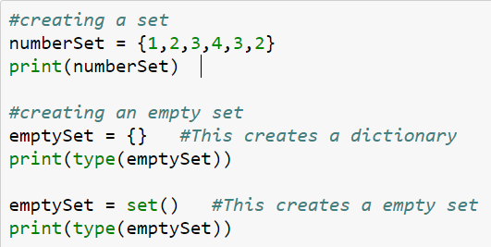
Sets:
A set is a collection which is unordered, unchangeable*, and unindexed.
Set items are unchangeable, but you can remove items and add new items.
A set is created by placing all the elements inside curly braces {}, separated by comma or by using the built-in function set(). The elements can be of different types (integer, float, tuple, string etc.).
{1,2,3,4}
{class, ‘dict’}
{class, ‘set’}

Slide 84
Sets are unordered: Unordered means that the items in a set do not have a defined order.
Set items can appear in a different order every time you use them and cannot be referred to by index or key.
Example:
set1={1, 2, 3, 4, 5, 6, 7}
print(set1) Output:
{1, 2, 3, 4, 5, 6, 7}
----------------------------------------------------------------------------------
Sets do not supporting indexing
myset = {'Apples', 'Bananas', 'Oranges’} >>> myset[0]
print(myset)
Output: {'Bananas', 'Oranges', 'Apples'}
Traceback (most recent call last): File "<pyshell#2>", line 1, in <module> myset[0] TypeError: 'set' object does not support indexing

Slide 85
Iteration over sets:
cannot access items in a set by referring to an index or a key.
But can loop through the set items using a for loop or ask if a specified value is present in a set, by using the in keyword.
Example:
thisset = {"apple", "banana", "cherry"}
for x in thisset:
print(x)
Output:
banana
apple
cherry

Slide 86
Set operations: like union, intersection, symmetric difference etc.
odd = {1, 3, 5}
prime = {2, 3, 5}
membership ∈ Python: in 4 in prime ⇒ False
union ∪ Python: | odd | prime ⇒ {1, 2, 3, 5}
intersection ∩ Python: & odd & prime ⇒ {3, 5}
difference \ or - Python: - odd – prime ⇒ {1}
------------------------------------------------------------------------------------Example:
set1 = {5, 6, 7, 8}
set2 = {1, 2, 3, 5, 6, 10}
intersection = set1 & set2
union = set1 | set2
diff1 = set1-set2
diff2 = set2-set1
print(set1,set2,intersection,union,diff1,diff2,sep="\n")
Output:
{8, 5, 6, 7}
{1, 2, 3, 5, 6, 10}
{5, 6}
{1, 2, 3, 5, 6, 7, 8, 10} {8, 7}
{10, 1, 2, 3}

Slide 87
Modify a Set: We cannot access or change an element of set using indexing or slicing.
Add one element to a set:
myset.add(newelt)
myset = myset | {newelt}
Update multiple elements to the set
myset.update((elt1, elt2, elt3))
Remove one element from a set:
myset.remove(elt) # elt must be in myset or raises error
myset.discard(elt) # never errors
myset = myset - {elt}
What would this do?
myset = myset – elt .clear() will remove all the elements
Remove and return an arbitrary element from a set:
myset.pop()
Note: add, remove and discard all return None

Slide 88
Exercise:
set1 = {5, 6, 7, 8}
set2 = set1
set3 = set(set1)
set1.update((9,10))
print(set1)
print(set2)
print(set3)
print(id(set1))
print(id(set2))
print(id(set3))
set1.add(11)
set2 = set2 | {35}
print(set1)
print(set2)
print(id(set1))
print(id(set2))
set1.remove(8)
set1.discard(7)
set2 = set2-{6, 10, 8}
set2.pop()
print(set1)
print(set2)
set2.clear()
print(set2)
Output:
{5, 6, 7, 8, 9, 10, 11}
{35, 5, 6, 7, 8, 9, 10, 11}
130450725009696
130450724999840
Output:
{5, 6, 9, 10, 11}
{5,7, 9, 11}
set()
Output:
{5, 6, 7, 8, 9, 10}
{5, 6, 7, 8, 9, 10}
{8, 5, 6, 7}
130450725009696
130450725009696
130450725010368

Slide 89
Methods on Sets:
isdisjoint() – This method returns True if none of the items are present in both sets, otherwise it returns False.
Syntax: set.isdisjoint(set)
issubset() – This method returns True if all elements of a set A are present in another set B which is passed as an argument, and returns False if all elements are not. You can also use the <= operator.
Syntax: set.issubset(set1) OR set <= set1
issuperset() – This method returns True if all elements of a set B are in set A. Then Set A is the superset of set B. You can also use the >= operator.
Syntax: set.issuperset(set) OR set >= set1

Slide 90
set1 = {"a", "b", "c"}
set2 = {"f", "e", "d", "c", "b", "a"}
disjoint = set1.isdisjoint(set2)
subset=set1.issubset(set2)
supset=set1.issuperset(set2)
print(disjoint)
print(subset)
print(supset)
set1 = {"a", "b", "c"}
set2 = {"f", "e", "d", "c", "b", "a"}
s1=set1 <= set2
s2=set1 >= set2
print(s1)
print(s2)
Output:
True
False
Output:
False
True
False

Slide 91
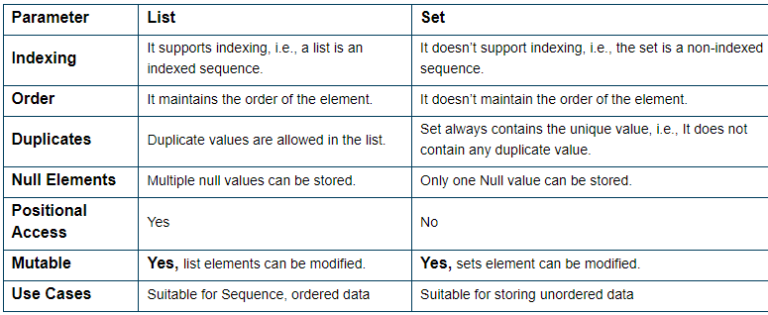
Difference between a Set and a list:

Slide 92
DICTIONARY

Slide 93
Dictionary:
A dictionary is a collection which is unordered, changeable and do not allow duplicates.
Dictionaries are collection of Key-Value pair. Dictionaries are used to store data values in key:value pairs. Key and values are separated by a colon. Pairs of entries are separated by commas.
Keys can be any immutable type and unique within the dictionary. Values can be any type. Dictionaries are written with curly brackets.
Python’s dictionaries are also known as hash tables and associative arrays
Dictionary items can be referred to by using the key name.

Slide 94
Creating & accessing dictionaries
Example 1:
d={"user":"admin","password":1234}
print(d)
print(d['user'])
print(d['password’])
Example 2:
thisdict = dict(name = "John", age = 36, marks=[10,20,30])
print(thisdict)
Output:
{'user': 'admin', 'password': 1234}
admin
1234
Output:
{'name': 'John', 'age': 36, 'marks': [10, 20, 30]}

Slide 95
Changing item value in Dictionary:
d = {'user':'admin', 'pswd':1234}
d['user'] = 'student'
print(d)
Output:
{'user': 'student', 'pswd': 1234}

Slide 96
Adding Items - Adding an item to the dictionary is done by using a new index key and assigning a value to it:
Example
thisdict = {"name":"John", "age":36}
thisdict["marks"]=100
print(thisdict)
Output:
{'name': 'John', 'age': 36, 'marks': 100}

Slide 97
Update Dictionary:
The update() method will update the dictionary with the items from a given argument. If the item does not exist, the item will be added.
The argument must be a dictionary, or an iterable object with key:value pairs.
Example
thisdict = {"user": "admin", "password": 1234}
thisdict.update({"dept": "cse"})
print(thisdict)
Output:
{'user': 'admin', 'password': 1234, 'dept': 'cse'}

Slide 98
Creating Dictionary fromkeys() method: The fromkeys() method returns a dictionary with the specified keys and the specified value. If the value parameter is not specified, it defaults to None.
Syntax: dict.fromkeys(seq, value=None)
Example 1:
x = ('key1', 'key2', 'key3')
y = 0
thisdict = dict.fromkeys(x, y)
print(thisdict)
Example 2:
x = ('key1', 'key2', 'key3')
thisdict = dict.fromkeys(x)
print(thisdict)
Output:
{'key1': 0, 'key2': 0, 'key3': 0}
Output:
{'key1': None, 'key2': None, 'key3': None}

Slide 99
Removing item from the Dictionary:
The del keyword removes the item with the specified key name.
The clear() method empties the dictionary.
The del keyword can also delete the dictionary completely
Example:
d = {'user':'admin', 'p':1234, 'i':34}
del d['user']
print(d)
d.clear()
print(d)
del d
#print(d)
Output:
{'p': 1234, 'i': 34}
{}

Slide 100
Removing item from the Dictionary: The pop() method removes the item with the specified key name. If the key is not found, a KeyError is raised.
Syntax: dict.pop(key, default=None)
Example:
stud={'name':'ram', 'id':1234, 'marks':100}
poppeditem=stud.pop('marks')
print('Popped value',poppeditem)
print(stud)
x=stud.pop('english','not found')
print(x)
keyname | Required. The keyname of the item you want to remove
defaultvalue | Optional. A value to return if the specified key do not exist. If this parameter is not specified, and no item with the specified key is found, an error is raised
Output:
Popped value 100
{'name': 'ram', 'id': 1234}
not found

Slide 101
Removing item from the Dictionary:
dict.popitem(): The popitem() method removes the item that was last inserted into the dictionary. In versions before 3.7, the popitem() method removes a random item from dictionary. If the dictionary is empty, a KeyError is raised.
Syntax: dictionary.popitem()
Example:
stud={'name':'ram', 'id':1234, 'marks':100}
poppeditem=stud.popitem()
print('Popped value',poppeditem)
print(stud)
Output:
Popped value ('marks', 100)
{'name': 'ram', 'id': 1234}

Slide 102
Useful Accessor’s in Dictionary:
>>> d.keys() - Returns a view object that displays a list of all the keys in the dictionary
my_dict = {'a': 1, 'b': 2, 'c': 3}
k = my_dict.keys()
print(k)
>>> d.values() - Returns a view object that displays a list of all the values in the dictionary
my_dict = {'a': 1, 'b': 2, 'c': 3}
val = my_dict.values()
print(val)
>>> d.items() - Returns a view object that displays a list of key-value pairs (tuples) in the dictionary
my_dict = {'a': 1, 'b': 2, 'c': 3}
i = my_dict.items()
print(i)
Output:
dict_keys(['a', 'b', 'c'])
Output:
dict_values([1, 2, 3])
Output:
dict_items([('a', 1), ('b', 2), ('c', 3)])

Slide 103
Difference between a list and a Dictionary:
Parameter | List | Dictionary
Definition | An ordered collection of items. | An unordered collection of data in a key: value pair form.
Syntax | Uses square brackets []. | Uses curly braces {}.
Ordering | Ordered: Items have a defined order, which will not change. | Unordered: Items do not have a defined order.
Indexing | Accessed by index, starting from 0. | Values are accessed using keys.
Mutability | Mutable: Items can be modified after creation. | Mutable: Values can be updated, and key: value pairs can be added or removed.
Uniqueness | Allows duplicate items. | Does not allow duplicate keys. However, values can be duplicated.
Data Types | It can store any data type. | Keys can be of any immutable data type (e.g., strings, numbers, tuples). Values can be of any type.
Use Case | When order matters or when you need to store multiple values for an item. | When you need a unique key for each piece of data.
Example | fruits = [“apple”, “banana”, “cherry”] | person = {“name”: “John”, “age”: 30}
Performance | Faster for ordered operations like sorting. | Faster for lookup operations due to the hash mapping of keys.

Slide 104
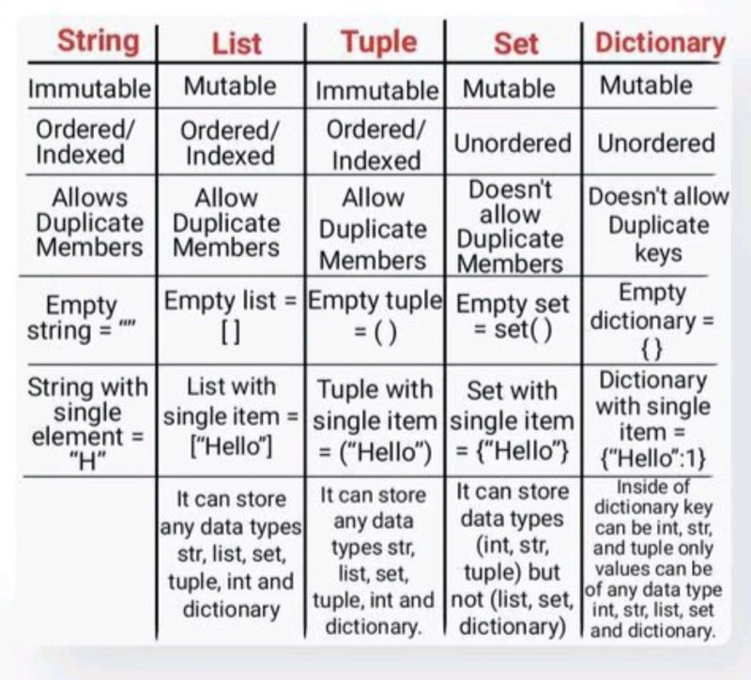
List v/s Tuple v/s Set v/s Dictionary:

Slide 105
Exercise:
What happens if you try to access a key that doesn’t exist in a dictionary?
Can dictionaries in Python contain mutable objects as keys?
What is the difference between dict.pop( ) and dict.popitem( )?

